Slide 1


DEPARTMENT OF AUTOMOBILE ENGINEERING
MIT CAMPUS, ANNA UNIVERSITY, CHENNAI – 44
SECOND REVIEW – PHASE 2
S.No | Name | Register Number
1 | NIROSHINI. K | 2019502032
2 | AKILAN. S | 2019502509
3 | DHINESH BABU. R | 2019502517
4 | HARI VIGNESH. N S | 2019502523
GUIDE:
Dr. A.Sangeet Sahaya Jeyangel,
Teaching Fellow,
Department of Automobile Engineering,
MIT campus, Anna university

Slide 2
TITLE
EXPERIMENTAL ANALYSIS OF PERFORMANCE,COMBUSTION AND EMISSION CHARACTERISTICS OF SINGLE CYLINDER DIESEL ENGINE USING BIODIESEL(DIESEL-TURPENTINE BLEND) WITH HYDROGEN INDUCTION.

Slide 3
INTRODUCTION
Entire worldwide, fossil reserves are getting scantier and progressively exorbitant with time.
Moreover, constant dependency on them leads to the frightening plight of global warming. Higher fuel prices and limited natural resources have forced the researchers to pursue research on green alternative fuels.
The use of biodiesel obtained from plants in internal combustion engine is finding its place to replace the use of conventional fuel. In our research, the performance, combustion and emission characteristics of diesel engine fueled with biodiesel (diesel-turpentine blend) with hydrogen induction.

Slide 4
LITERATURE SURVEY
SI NO | JOURNAL NAME | YEAR | TOPIC | AUTHORS | INFERENCE
1 | Elsevier | 2019 | Experimental study on the effect of cetane improver with turpentine oil on CI engine characteristics | A.K.Jeevanantham, D.Madhusudan reddy,B.Ashok, Aman kumar | A novel cetane improver called SC5D is added with 20% blend of turpentine with diesel. For higher Nox emission condition,10% of EGR is applied. At this condition, unburned HC and smoke emissions are remarkably lower.
2 | Researchgate | 2017 | A review on novel bio-fuel from turpentine oil | Mehmet Hakki Alma, Tufan Salan | At 40% blend of turpentine oil with diesel mixture shows 2.5% increase in BTE than the diesel. nearly 50% smoke was reduced but a little shoot and co was found.

Slide 5
SI NO | JOURNAL NAME | YEAR | TOPIC | AUTHORS | INFERENCE
3 | Elsevier | 2018 | Influences of dual bio-fuel (Jatropha biodiesel and turpentine oil) on single cylinder variable compression ratio diesel engine | Pankaj Dubey, Rajesh Gupta | Experiments have been accompanied at CR of 15.5:1,17:1,18.5:1 and 20:1. Biofuel blend (JBT50) resulted at full load and CR 20:1,there was 2.17% increase inBTEand13.04%,17.5%,4.21% and 30.8% decrease in CO,HC, NOx and smoke and 11.04% increase in CO respectively.
4 | Elsevier | 2010 | Performance and exhaust emission of turpentine oil powered direct injection diesel engine | B. Prem Anand, C.G. Saravanan, C. Ananda Srinivasan | 30% of turpentine oil blend with diesel produce high brake power and net heat release rate with a net reduction in CO,HC,Nox,smoke and particulate matter. 40% and 50% blends produce lower brake power.

Slide 6
SI NO | JOURNAL NAME | YEAR | TOPIC | AUTHORS | INFERENCE
5 | Elsevier | 2019 | Control of backfire and NOx emission reduction in a hydrogen fueled multi-cylinder spark ignition engine using cooled EGR and water injection strategies. | Vipin dhyani,K.A. Subramanian. | The experimental test was conducted on a engine with varied EGR rate (0% - 28% volume) and water to hydrogen ratio (0-9.25) at 15kW load It was found that at 25% EGR,there was 57% reduction in Nox,with WHR of 7.5, the Nox emission was reduced by 97% without affecting the efficiency.
6 | Elsevier | 2011 | Hydrogen effects on Nox emissions and brake thermal efficiency in a diesel engine under low-temperature and heavy –EGR ondition. | Buomsik shin,Youngsoo cho,Daeha han,Soonho song | The experiment was observed over a constant EGR ratios of 2,16 and 31%. The Nox reduction due to hydrogen addition increased at higher EGR ratio. At 31% EGR ratio,the Nox was lowered by 25% and a slight increase in brake thermal efficiency.

Slide 7
RESEARCH GAP
A review on novel bio-fuel from turpentine oil by Mehmet Hakki Alma, Tufan Salan (2017) - has discussed about the use of 40% of turpentine oil blend with diesel in diesel engine.
Influences of dual bio-fuel (Jatropha biodiesel and turpentine oil) on single cylinder variable compression ratio diesel engine by Pankaj Dubey, Rajesh Gupta (2018) – has discussed about the use of jatropha and turpentine oil blend in single cylinder diesel engine.
But so far no one has explored the arena of using hydrogen induction with turpentine blend with diesel and analyzing the performance, combustion and emission characteristics of single cylinder ci engine.

Slide 8
AIM & OBJECTIVE
To experimentally test the performance , combustion , emissions characteristics of single cylinder diesel engine using biodiesel.
Objective is to compare the characteristics of biodiesel blends(diesel-turpentine) and the same with hydrogen induction for the best two blends (B20 and B30).

Slide 9
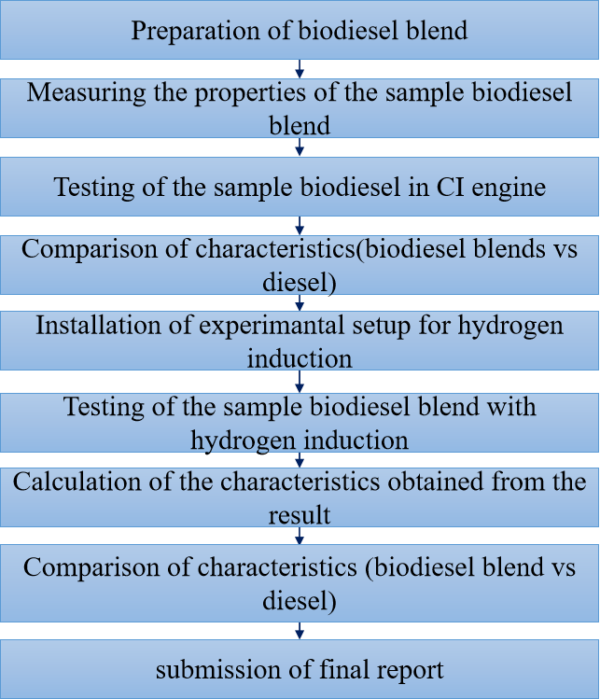
METHODOLOGY

Slide 10
WHY TURPENTINE OIL?
Turpentine oil is physically a yellowish, opaque, odorous and water-immiscible liquid when it is chemically flammable,volatile and combustible.
Turpentine oil is mixture of α- and β- pinenes(30% and 60% respectively) and other isometric terpenes.
Turpentine oil is extracted from the resin of pine tree(genus pinus) saps and leaves.
Turpentine oil having low viscosity and lower carbon resides and environmentally friendly due to its low Sulphur content Also, the properties of turpentine oil are similar with diesel.

Slide 11
PROPERTIES OF FUEL
BLEND | DENSITY(g/m³) | KINEMATIC VISCOSITY ( m²/s) | FLASH POINT (°c) | FIRE POINT (°c)
DIESEL | 0.827 | 13.28 | 47 | 54
B20 | 0.831 | 14.567 | 49 | 55
B30 | 0.835 | 14.147 | 52 | 57
B40 | 0.839 | 13.360 | 55 | 60
B50 | 0.844 | 13.055 | 57 | 62
TURPENTINE | 0.845 | 10.870 | 53 | 58

Slide 12
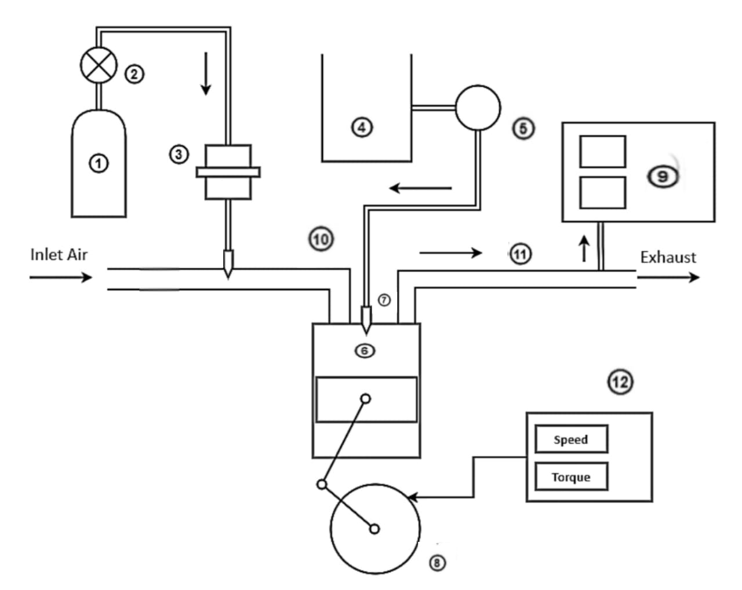
ENGINE LAYOUT
① - Hydrogen Storage Tank
② - Pressure Regulator
③ - Flame Arrestor
④ - biodiesel-Diesel blend tank
⑤ - Fuel Pump
⑥ - Diesel Engine
⑦ - Fuel Injector
⑧ - Crank Wheel
⑨ - Exhaust Gas Analyzer
⑩ - Inlet Manifold
⑪ - Exhaust Manifold
⑫ - Dynamometer

Slide 13
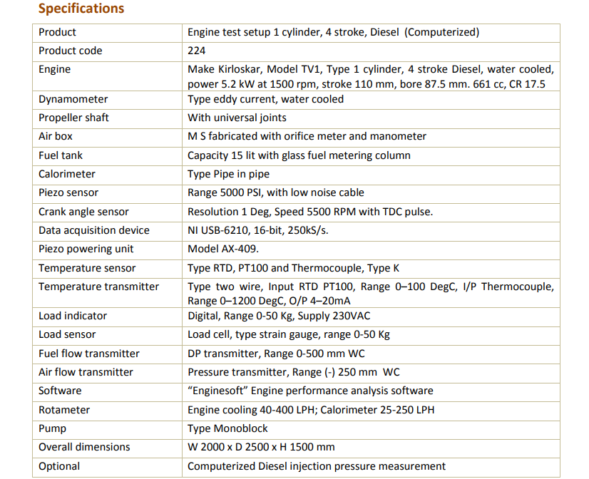
ENGINE SPECIFICATIONS

Slide 14
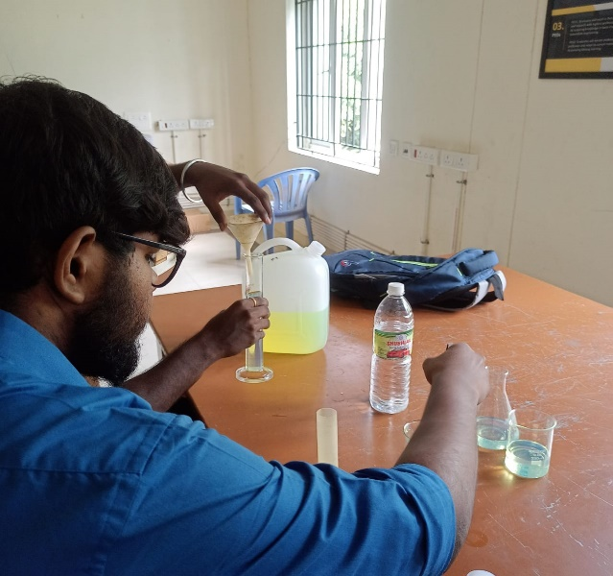
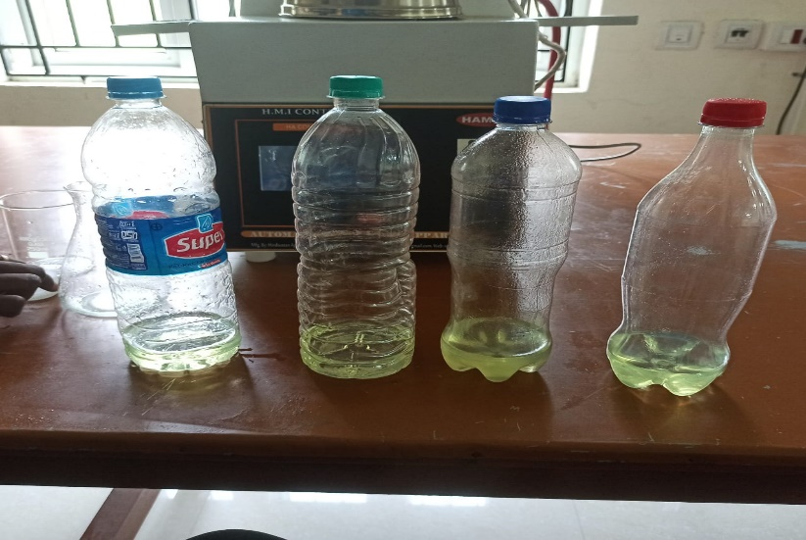
PREPARATION OF BIO-DIESEL BLEND
From the result of phase 1, we choose 2 blends (B20 and B30) from the 4 blends (B20,B30,B40 and B50).
These two blends were taken based on their brake thermal efficiency of 31.92% for B20 blend and 31.71% for B30 blend at full load (100%) when compared to the other blends.

Slide 15
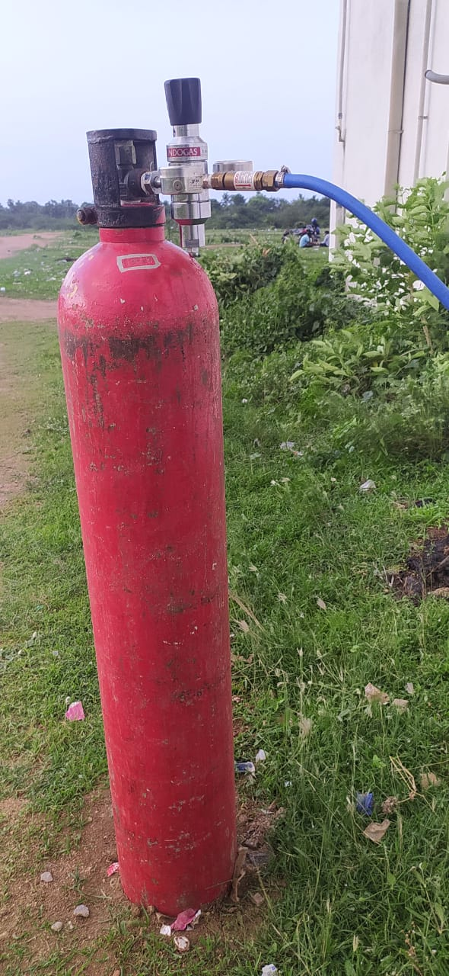
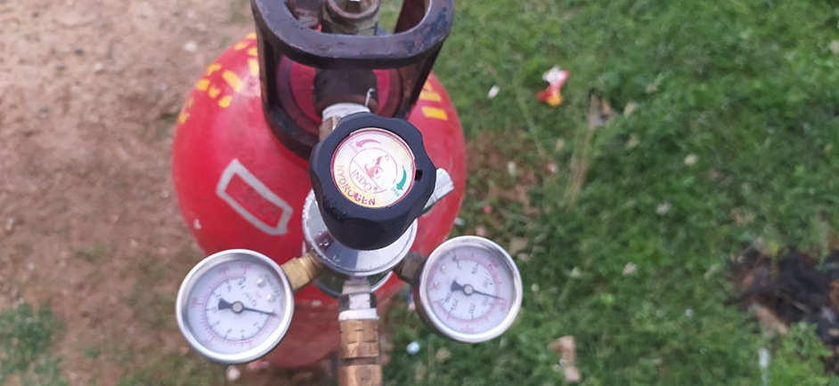
INSTALLATION OF HYDROGEN INDUCTION SETUP
HYDROGEN CYLINDER:
Hydrogen is stored in a
Metallic cylinder in a
compressed Gaseous state.
Hydrogen was stored
Under the pressure of 260
bar for this project.
PRESSURE REGULATOR:
A pressure regulator is a valve that controls the pressure of a fluid or gas to a desired value, using negative feedback of controlled pressure.

Slide 16
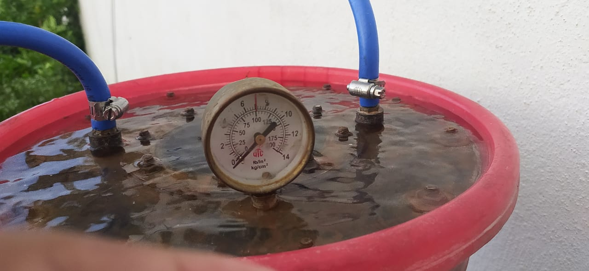
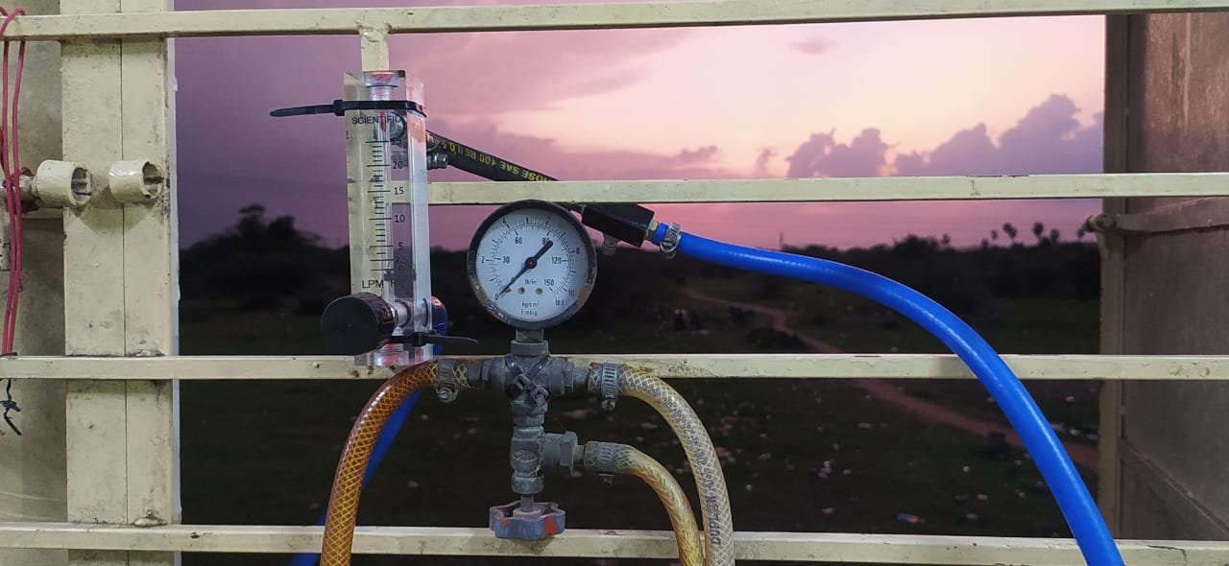
INSTALLATION OF HYDROGEN INDUCTION SETUP
FLAME TRAP:
A flame trap or flame arrestor is used to arrest backfire in H2 supply line which reduces the risk of explosion
FLOW METER:
Flowmeter is connected next to flame trap to measure the flow of hydrogen.it measures the supply of hydrogen gas in litre per minute (LPM)

Slide 17
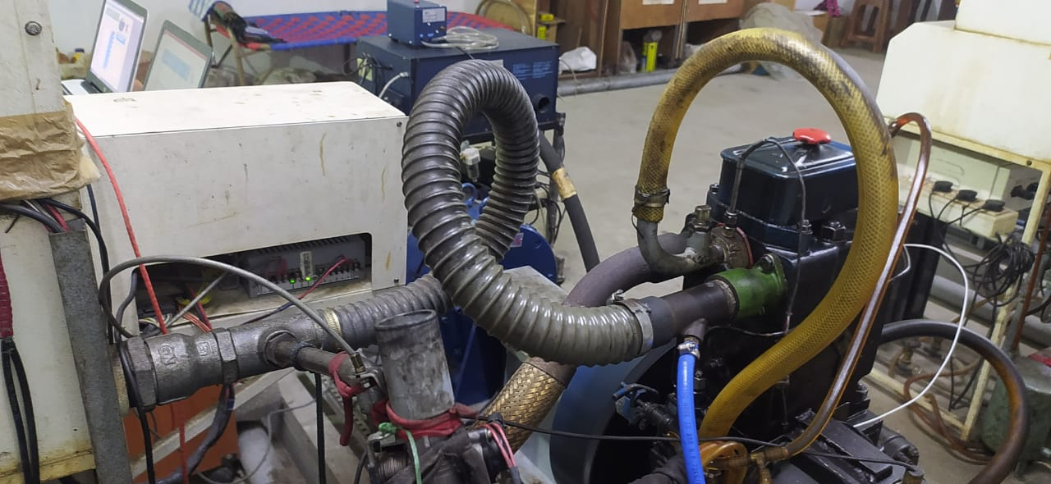
HYDROGEN INDUCTION SETUP

Slide 18
PERFORMANCE CHARACTERISTICS

Slide 19
SPECIFIC FUEL CUNSUMPTION

Slide 20
COMBUSTION CHARACTERISTICS

Slide 21
HEAT RELEASE RATE

Slide 22
EMISSION CHARACTERISTICS

Slide 23
HC Vs LOAD

Slide 24
CO₂ Vs LOAD

Slide 25
Nox Vs LOAD

Slide 26
SMOKE Vs LOAD

Slide 27
INFERENCES-PERFORMANCE CHARACTERICTICS
Brake Thermal Efficiency
BTE is less when using biodiesel, because of the poor volatilability and inferior combustion characteristics of the biodiesel.
The high flame velocity of the hydrogen, which is added to the intake air increases the combustion rate during combustion. This results in higher BTE. The BTE of B20H2 is 33.58% and B30H2 is 32.24% at 100% load.
Specific Fuel Consumption
The bio diesel has lower calorific value than neat diesel. Hence more amount of fuel is consumed to produce the same power output produced by the diesel.
Hydrogen addition decreases SFC of the engine due to the superior combustion characteristics of the fuel mixture along with hydrogen.
The high flame velocity will increase the combustion rate and this in turn reduces SFC

Slide 28
INFERENCES-COMBUSTION CHARACTERICTICS
In cylinder pressure
The biodiesel generated less cylinder pressure when compare with the diesel. This is due to the poor calorific value which results in inferior combustion.
The superior properties and the higher flame velocity of the hydrogen results in complete oxidation of premixed charge that significantly increase the cylinder’s pressure.
Heat Release Rate
The biodiesel releases less heat compare with diesel, due to the less calorific value of the biodiesel.
The increased ignition delay of the hydrogen improves the combustion. Hence the heat release rate with hydrogen enrichment will be higher

Slide 29
INFERENCES-EMISSION CHARACTERICTICS
CO
More amount of oxygen content and lower carbon molecules of the biodiesel will result in reduction in CO emissions.
The hydrogen molecules will react with the oxygen present in biodiesel will form OH molecules.
This improves the combustion process and reduces the formation of CO emission in the exhaust.
HC
Biodiesel contains more oxygen content and higher cetane number will decrease the ignition delay period. This will increase the combustion rate.
The rapid burning rate of the hydrogen fuel will result in combustion rate and decreases HC emissions.

Slide 30
Smoke opacity
The biodiesel has higher oxygen content that enhances the combustion rate and improves the oxidation of the fuel mixture. This reduces the formation of smoke.
The addition of hydrogen increases the combustion by secondary oxidation and burns the unburned particles. This reduces the smoke opacity.
NOx emissions
The increase in NOx emissions while using biodiesel is due to the presence of more oxygen molecules which results in complete combustion and increase in incylinder temperature.
Higher calorific value of hydrogen fuel will release more heat energy during combustion, which also increases peak temperature. Hence hydrogen enrichment will result in more NOx emissions

Slide 31
THANK YOU

